Slide 1


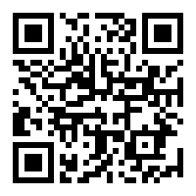


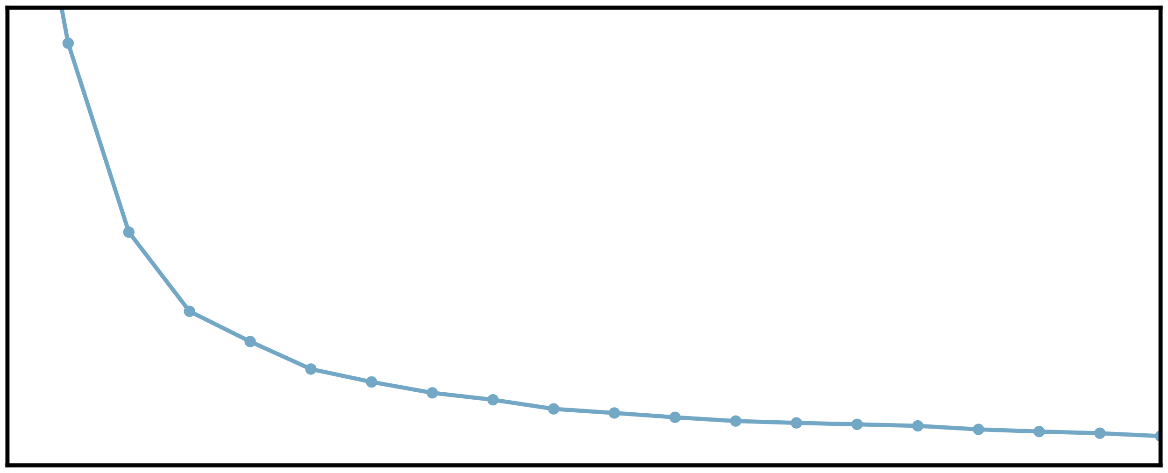
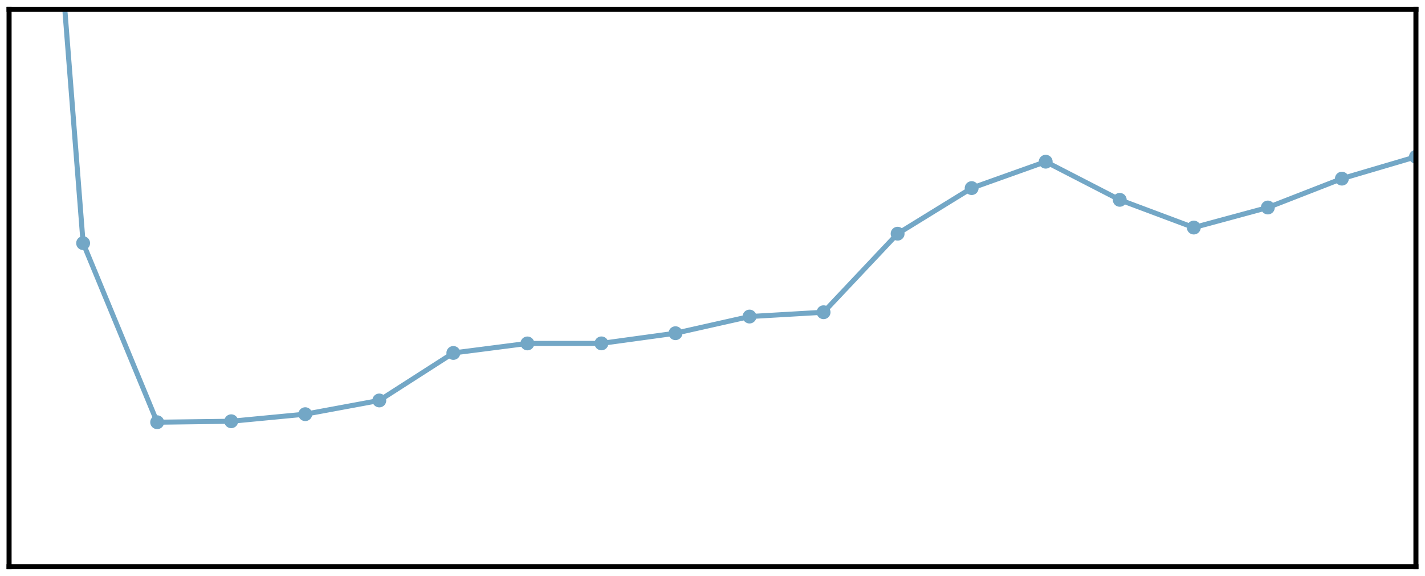
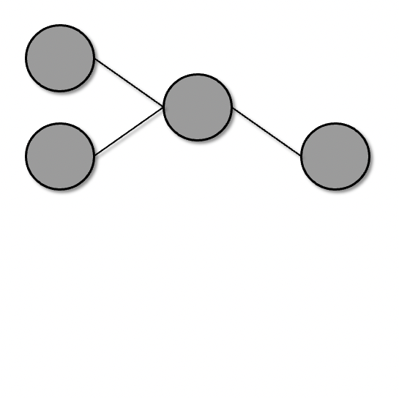
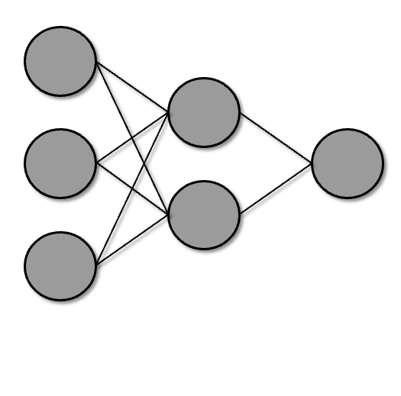
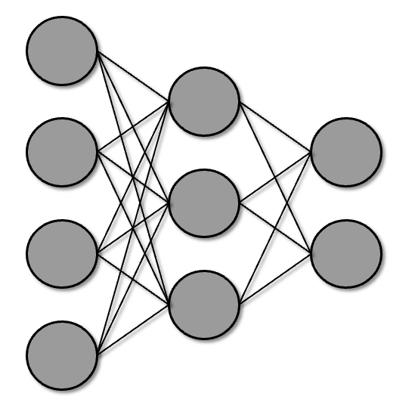
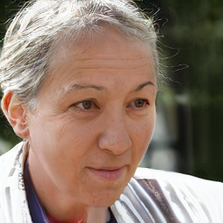
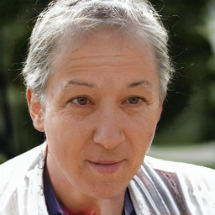
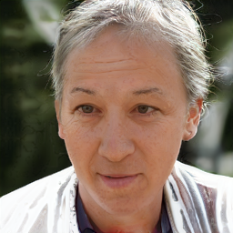



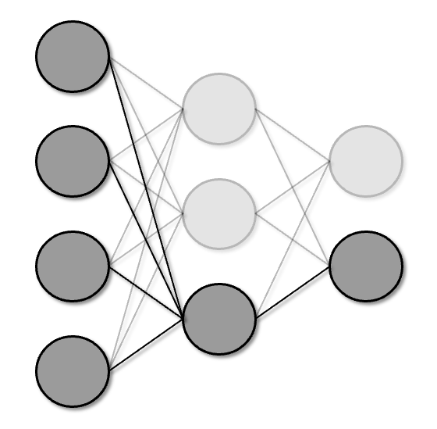
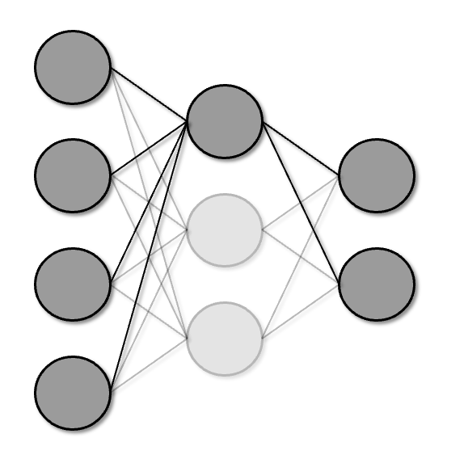
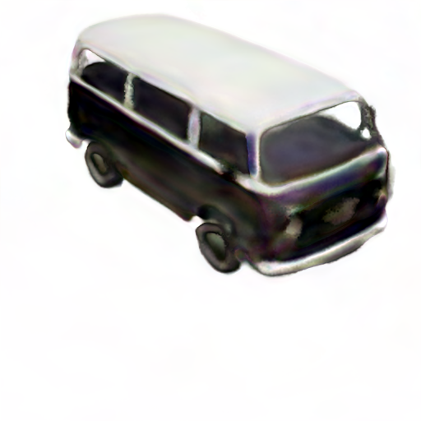
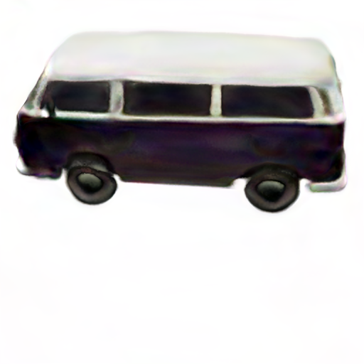
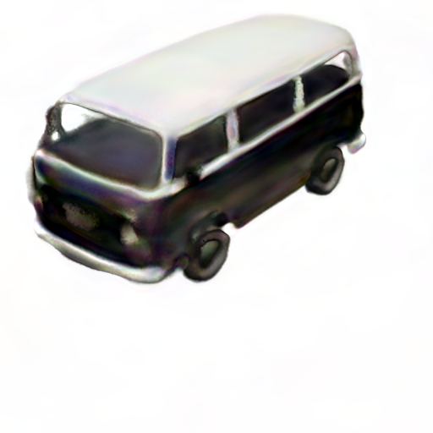
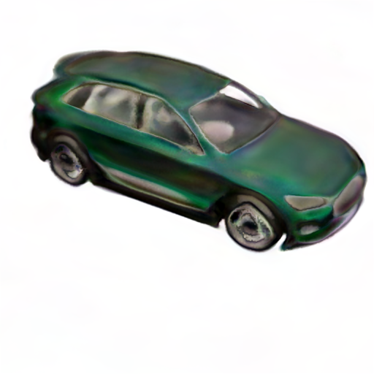
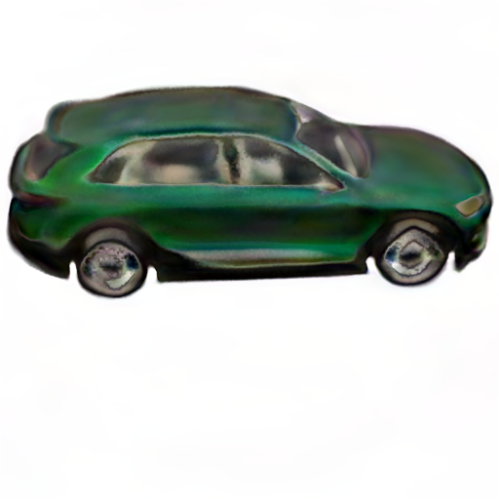
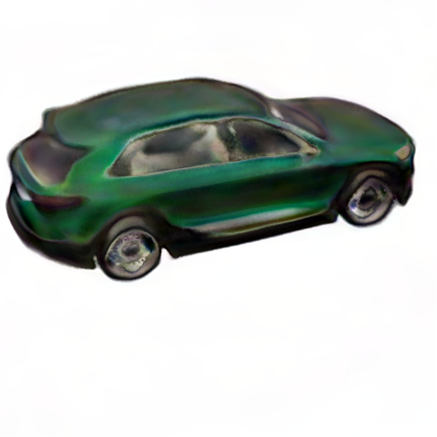
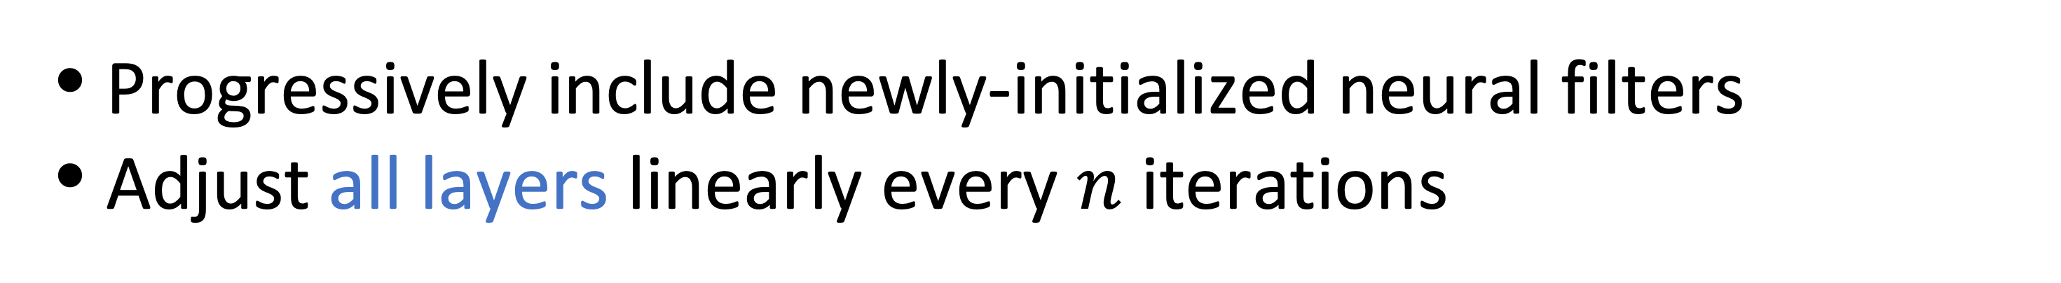
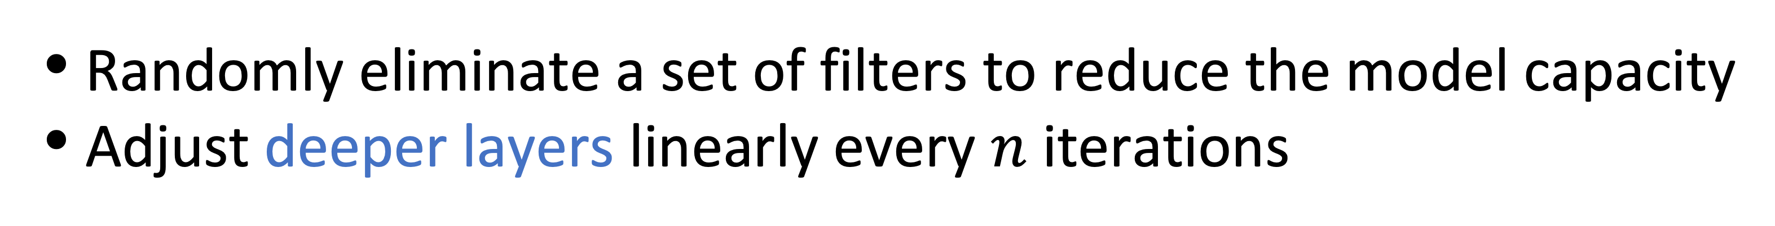
Improving GANs with A Dynamic Discriminator
Code Available
Ceyuan Yang*, Yujun Shen*, Yinghao Xu, Deli Zhao, Bo Dai, Bolei Zhou
Bi-classification task difficulty for discriminator is data-dependent and time-varying.
Experimental results
Various data regimes require different adjustment strategies
Training under sufficient data
Training under limited data
FID | FFHQ-2K (Limited data) | FFHQ-140K (Sufficient data)
StyleGAN2 | 78.82 | 3.75
w/ increasing capacity | 63.16 | 3.53
w/ decreasing capacity | 23.47 | 3.74
Task becomes harder
FID
FID
Results on other image datasets
Task becomes easier
FID | Cat | Dog | Wild life
StyleGAN2 | 6.36 | 18.93 | 3.80
w/ DynamicD | 5.41 | 16.00 | 3.34
Church | Bridge | Bedroom
4.44 | 6.20 | 5.65
3.87 | 5.33 | 4.01
AFHQ (Limited data)
LSUN (Sufficient data)
Thus, a discriminator with fixed capacity may not work well under different data condition during training
DynamicD: adjusting discriminator capacity during training
Results on 3D-aware image synthesis
Increasing strategy under sufficient data
FID | FFHQ-2K (Limited) | FFHQ-140K (Sufficient) | Carla-2K (Limited) | Carla-10K (Sufficient)
StyleNeRF | 73.50 | 8.13 | 72.1 | 53.87
w/ DynamicD | 23.29 | 7.60 | 51.0 | 47.42
Progressively include newly-initialized neural filters
Adjust all layers linearly every $n$ iterations
Qualitative results
Increasing capacity over time (from 0.5 to 1)
Decreasing strategy under limited data
Randomly eliminate a set of filters to reduce the model capacity
Adjust deeper layers linearly every $n$ iterations
Decreasing capacity over time (from 1 to 0.5)

